Slide 1
A Survey of Peer-to-Peer Content Distribution Technologies STEPHANOS ANDROUTSELLIS-THEOTOKIS DIOMIDIS SPINELLIS Athens University of Economics and Business
M1522.006300 Distributed Systems 2020 Fall Project
Hyun Sik Yang, Hyun Ji Kim
Seoul
22nd of Oct, 2020
Notes:
This report surveys aim to provide a comprehensive explanation of p2p applications, features, and implementation techniques

Slide 2
Defining Peer-to-Peer Computing
Peer-to-Peer computing
- Resource sharing is the purpose
- Make interconnected nodes to self-organize into network topologies
- Capable of adapting failures
- Accommodating transient population of nodes while maintain acceptable connectivity &
performance
- Not requiring intermediation or global centralized server support
Notes:
자원 공유가 목적, 상호연결된 노드가 network topolog에 self-organize 할수 있게 함, 또 failure를 adapt 하는데 capable 하며 노드의 transient population을 accommodate하는 동시에 acceptable 한 connectivity와 performace를 유지
그리고 마지막으로 중재나 global centralized server support를 요구하지 않음
( does not need an expensive server because individual workstations are used to access the files, but files cannot be centrally backed up)
- Sharing resources: CPU cycles, storage, bandwidth

Slide 3
Peer-to-Peer and Grid Computing
Grid computing
Distributed systems that enable the large-scale coordinated use and sharing of geographically
distributed resources, based on persistent, standards-based service infrastructures, often with
a high-performance orientation
Difference between peer-to-peer and grid computing
Peer-to-Peer | Grid computing
Dealing with Fault tolerance Instability Self adaptation Transient populations | Dealing with Fault tolerance Scalability Self-configuration persistent
Notes:
both concern with the organization of resource sharing in large-scale computational societies

Slide 4
Classification of Peer-to-Peer Applications
Communication and collaboration
Provide the infrastructure for facilitating direct, real-time communication and collaboration between peer computers
e.g. Chart/Irc, Instant Messaging, and Jabber
Distributed computation
Breaking down a computer-intensive task into small work units and distributing them to different peer computer, that
execute their corresponding work unit and return the results
Internet service support
Supporting a variety of internet services
e.g. peer-to-peer multicast systems, Internet indirection infrastructures and security applications
* interatice stock chart
** communication method
Notes:
P2P적용 분류
Communication and collaboration : peer 컴퓨터 간 direct한 real-time communication and collaboration 촉진하는 인프라 제공
Distributed computation: 컴퓨터의 intensive task를 작은 작업 단위로 나누어서 다른 peer compute에 distribute함 그 컴퓨터는 corresponding work unit 실행하고 결과 return ( 사용가능한 피어 컴퓨터의 능력을 활용)
Internet service support:
Data base system:
Content distribution:

Slide 5
Classification of Peer-to-Peer Applications
Database systems
Drawbacks of traditional architecture such as fails to serve in file sharing areas, server overload issues are resolved
Clients provide file or file fragments to each other
Content distribution
Peer-to-peer content distribution systems range from relatively simple direct file sharing applications, to more
sophisticated systems that create a distributed storage medium for securely and efficiently publishing, organizing,
indexing, searching, updating, and retrieving data
Notes:
데이터베이스 시스템은 전통적으로 클라이언트-서버 아키텍처를 사용해옴, 서버가 오버로드되면 클라이언트는 쿼리 응답 시간이 증가하며 최악의 경우 서버가 서비스를 제공하지 못함 파일 공유 영역에서, 서버 과부하 문제는 클라이언트(피어)가 서로 파일 또는 파일 조각을 제공하는 P2P(Peer-to-Peer) 기법을 사용함으로써 성공적으로 해결
피어 투 피어 컨텐츠 배포 시스템은 비교적 단순한 직접 파일 공유 애플리케이션에서 안전하고 효율적으로 게시, 구성 및 구성할 수 있는 분산 스토리지 미디어를 만드는 보다 정교한 시스템에 이르기까지 다양함 데이터를 인덱싱, 검색, 업데이트 및 검색합니다.

Slide 6
Peer-to-Peer Content Distribution
Peer-to-Peer Applications | Peer-to-Peer “file exchange“ systems | Simple, one-off file exchanges between peers Setting up a network of peers and providing facilities for searching and transferring files between them
 | Peer-to-Peer content publishing and storage system | Creating a distributed storage medium Security and persistence are main focus
Peer-to-Peer Infrastructures | Routing and location | Route with efficiency and fault tolerance, efficiently locating peers and content
 | Anonymity | Provide user anonymity
 | Reputation management | Reputation update with various network nodes
Notes:
P2P infrastructures that do not constitute working applications but provide p2p based services and application frameworks
p2p applications are based on p2p technology. it can be divided into two groups

Slide 7
Peer-to-Peer Distributed Object Location and Routing
Overlay Network Centralization
Purely Decentralized Architectures | All nodes in the network perform exactly same tasks, acting both as servers and clients No coordination
Partially Centralized Architectures | Similar to purely decentralized architecture but some nodes have more important role e.g. acting as local central indexes for files shared by local peers
Hybrid Decentralized Architectures | Central server facilitating the interaction between peers by maintaining directories of metadata, describing the shared files stored by peer node
Notes:
The operation of any peer-to-peer content distribution system relies on a network of peer computers (nodes), and connections (edges) between them
This network is formed on top of the underlying physical computer network and it's called overlay network. Overlay networks can be divided in terms of their centralization and structure.

Slide 8
Peer-to-Peer Distributed Object Location and Routing
Overlay Network Structure
Unstructured Networks | Structured Networks
No specific topology | predetermined topology
Random connections | predetermined connections
appropriate for accommodating highly-transient node population | hard to maintain the structure required for efficiently routing messages in the face of a very transient node population
resilient in attacks | vulnerable in attacks
Examples: Napster, Publius, Edutella, FreeHaven,Kazaa | Examples: Chord, CAN,PAST,Tapestry

Slide 9
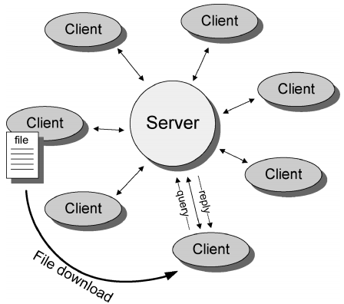
Peer-to-Peer Distributed Object Location and Routing
Unstructured Architectures
Hybrid Decentralized
Each client computer stores content (file) shared with the network Client that wishes to join the network contact the central server and reports the files Client send request for files to the server Server searches for matches in its index, returning a lost if users that hold the matching file User opens direct connections with one or more of the peers that hold the requires file and download it
Architecture of typical hybrid decentralized peer-to-peer system
Notes:
advantage: simple to implement, locate files quickly and efficiently
disadvantage: vulnerable to censorship, legal action, surveillance, malicious attack and technical failure
in unstructured architectures, there are another three groups to divide the this architecture

Slide 10
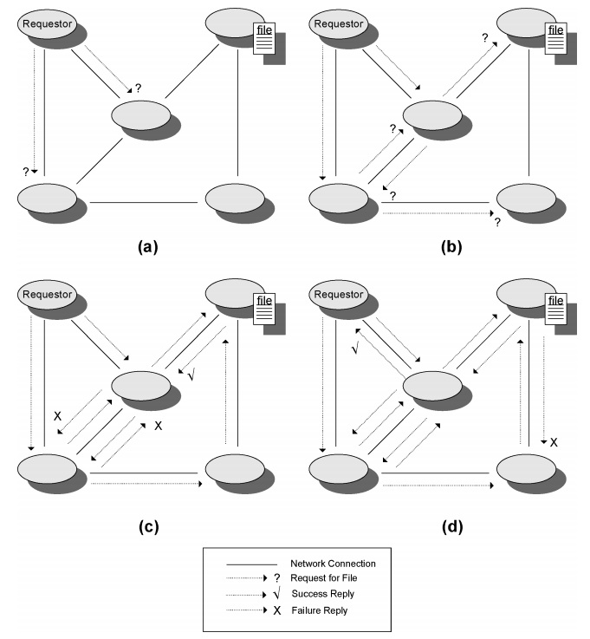
Peer-to-Peer Distributed Object Location and Routing
Unstructured Architectures
Purely Decentralized
No central coordination in the network and users connect to each other directly Users use IP as its underlying network service Communication between clients is specified in a form of application level protocol supporting four types of messages - Ping: request for a certain host to announce itself - Pong: reply to a Ping message - Query: search request - Query hits: reply to a query message
Architecture of typical purely decentralized peer-to-peer system
Notes:
Gnutella

Slide 11
Peer-to-Peer Distributed Object Location and Routing
Unstructured Architectures
Partially Centralized
Similar to purely decentralized apart from the usage of supernodes Supernode: nodes that are dynamically assigned the tasks of servicing a small subpart of the peer network by indexing and caching filed contained Peers are automatically elected to become supernodes if they have sufficient bandwidth and processing power
Notes:
If there is a error in one or more supernode, the node connected with other super node so it makes keep operating
All of the node is equally loaded in the decentral but supernode is used in partially
Kazaa, Gnutella, Edutella
shorten time of discovery without failure and inherent heterogeneity of peer-to-peer network is exploited are the advantages

Slide 12
Peer-to-Peer Distributed Object Location and Routing
Structured Architectures Overview
Loosely Structured |  | Freenet | Uses file and node identifier similarity to estimate a file location Uses Chain mode propagation approach
Structured |  | Chord | nodes maintain a distributed routing table in the form of all nodes are mapped & associated finger table
 |  | CAN | Use n-dimensional Cartesian coordinate space to implement the distributed location and routing table Each node is responsible for a zone in the coordinate space
 |  | Tapestry | Based on the plaxton mesh data structure Maintains pointers to nodes in the network whose IDs match the elements of a tree-like structure of ID prefixes up to a digit position
Notes:
chain mode propagation – to forwarding queries from node to node ( 노드간의 쿼리 전달 하기 위해서 )/ system
이 데이터 구조는 ID가 ID prefix의 트리 구조 요소와 일치하는 네트워크 노드에 대한 포인터를 자릿수 위치까지 maintain

Slide 13
Peer-to-Peer Distributed Object Location and Routing
Loosely Structured Architectures Example
: Freenet
Purely decentralized loosely-structured content distribution system Self-organizing peer-to-peer pooling unused disk space in peer computer to create a collaborative virtual file system Each freenet node maintains its own local data store use 4 messages Data insert: A node inserts new data in the network. A key and the actual data are included Data request: A request for a certain file. The key of the file requested is also included Data reply: A reply initiated when the requested file is located. The actual file is also included in the reply message Data failed: A failure to locate a file. The location of the failure and the reason are also included
Notes:
Each Freenet node maintains local data store & dynamic routing table
, which all include the node identifier, a hops-to-live value, and the source and destination node identifiers:

Slide 14
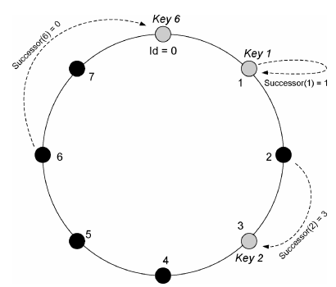
Peer-to-Peer Distributed Object Location and Routing
Structured Architectures Examples
: Chord
Performs a mapping of file identifiers onto node identifier Data location can be implemented on top of Chord by identifying data items (files) with keys and storing the (key, data item) Nodes are also identified by keys Keys are assigned both to file sand nodes by means of a deterministic function All node identifiers are ordered in an identifier circle modulo 2 to the m Key k assigned to the first node whose identifier is equal to, or follow k = successor node of key k
Notes:
Figure 5 m = 3

Slide 15
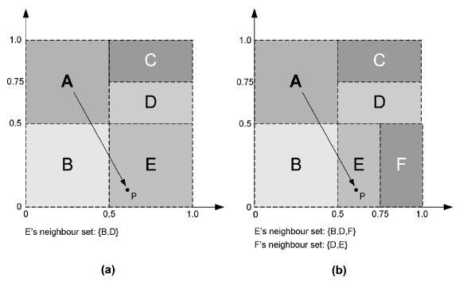
Peer-to-Peer Distributed Object Location and Routing
Structured Architectures Examples
: CAN (Content Addressable Network)
Hash Table
Maps file names to location
(key,value) pairs in the table
Support insertion, lookup, and deletion
Node stores a zone of the hash table
Cartesian coordinate space store (key K, value V) pairs
Key K is mapped onto a point P
Routing works by following the straight line path through
Cartesian space
A node Joins,
Allocated its portion by splitting the allocated zone of an existing node in half
A node leaves,
Hash table entry is handed over to one of its neighbors
Notes:
-each individual node of the Can network stores a part of the hast table
-CAN uses a virtual d-dimensional Cartesian coordinate space to store
(key K, value V)

Slide 16
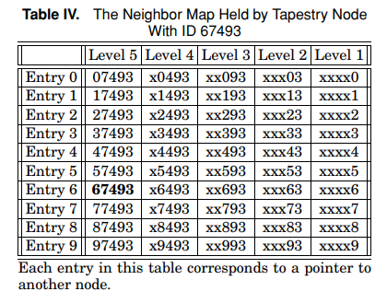
Peer-to-Peer Distributed Object Location and Routing
Structured Architectures Examples
Tapestry
Each level ℓ containing points to nodes whose ID must be matched with ℓ digits Each entry in the neighbor map corresponds to a pointer to the closest node in the network ID matches the number in the neighbor map up to a digit position
Notes:
Based on the location and routing mechanisms. each node maintains a neighbor map.

Slide 17
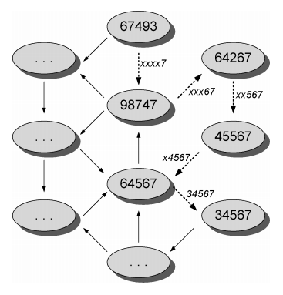
Peer-to-Peer Distributed Object Location and Routing
Structured Architectures Examples
: Tapestry
Plaxton mesh routing example: Message from node with ID = 67493 → Node ID = 34567 Digits are resolved right to left xxxx7 → xxx67 → xx567 → x4567 → 34567

Slide 18
Peer-to-Peer Content Distribution systems & Architectures Overview
By Centralization
By Structure
Notes:
오른쪽 Network Centralization
아래: Network structure

Slide 19
Content Caching, Replication and Migration
When multiple clients access one content
☞ Accessibility and performance issues if content is stored on only one node
Copy content to multiple nodes
improving availability
enhancing performance
resisting censorship attempts
Copying method
passive replication : Copy/Send on request
cache-based replication : Save copied content from other nodes once
active replication : The administrator actively stores data before the request is received
Instrospective replica management : Predict the request and replicate it enough to accommodate it
Dynamic replica management : If content is not available in response time, duplicate it additionally
Weakness of copying
More complex content security and integrity verification
Notes:
So far we have looked at the whole p2p system. From now on, we are going to look at issues related to how to copy and store content in order to operate the p2p system well. Consider situations in which multiple clients want to access the same content.
Accessibility and performance issues if content is stored on only one node.
Therefore, one content should be copied and stored on multiple nodes. This allows improving availability, enhancing performance, resisting censorship attempts
Typical methods for copying are as follows.
passive replication : it just Copy/Send on request from client
cache-based replication : When requested, the contents are cached.
More complex methods include
The administrator actively stores data before the request is received
for example, Predict the request and replicate it enough to accommodate it. the other solution is, If content is not available in response time, duplicate it additionally
However, verification of security and data integrity becomes more difficult after copying. How can we solve this problem?

Slide 20
Security
Secure Storage
Data integrity check
Minimize the possibility of data contamination
Self-Certifying Data
Receive data and its hashed key together to verify the integrity of the data
Information Dispersal
Encoding files divided into m blocks. Obtain integrity at m/n rate when n(n>m) of blocks are sent
Prevent malicious access to data secretly
Shamir’s Secret Sharing Scheme (SHA)
Encrypts files and divides them into $l$. a node can restore files using $k$ of these
Check at least k nodes to view files
Notes:
p2p는 신원을 알 수 없는 노드도 얼마든지 참여할 수 있기 때문에, 데이터는 언제나 오염될 가능성이 있다. 따라서 데이터의 무결성을 확인해야 한다.
Self-certifying은 데이터와 그 hash 키를 전송 받아 데이터를 검증하는 가장 간단한 방법이다.
information dispersal은 오염된 노드에서 데이터를 전송받을 가능성을 낮추기 위해, 파일을 m개 블록으로 나누어 저장하고, 파일을 m보다 큰 n개의 노드에서 전송 받는다.
데이터에 대해 악의적으로 접근하는 노드도 있을 수 있다
SHA는 파일을 l개로 나누어 저장한다. 노드는 k개의 다른 노드에서 이를 전송 받아야 파일을 복호화할 수 있다. SHA를 이용하면 하나의 데이터를 이용하기 위해 최소한 k개의 다른 노드에게 확인을 받아야 하는 것이다.
Because p2p can participate in any number of unidentifiable nodes, data is always likely to be contaminated. Therefore, the integrity of the data should be verified. Self-certifying is the simplest way to verify data by receiving the data and its hash key. In order to reduce the possibility of receiving data from contaminated nodes, contents split m blocks and transfers files from n nodes larger than m. Some nodes may have malicious access to data. SHA stores files divided into numbers of l files. A node must be sent from k different nodes before it can decrypt the file. SHA requires confirmation from at least k different nodes to use one data.

Slide 21
Security
Secure Storage
If content is only transferred from origin to destination
☞ Hackers may find and attack the origin node
Send through multiple nodes, and hide transfers
Anonymous Cryptographic Relays
Encrypt files and then send copies to other nodes as anonymous
Nodes do not store the transferred files, they just send them to their destination
Decrypt files only in at destination
Erasure Coding
Split data, store it, combine it only when used to ensure unity
Distributed Steganographic File Systems
Encrypt and mix files and store them in blocks; don't know which files are located node where
Notes:
Security issues also involve storing data.
If content is only transferred from origin to destination, Hackers may find and attack the origin node
so that we have to send data through multiple nodes, and hide transfers
The simplest way is to forward files across multiple nodes. At this time, the node that received the delivery role did not open the file, but merely retransmitted it to the purpose.
In order to force a file not to be opened while it is being transferred, error coding can be used.
for the higher security level, Encrypt and mix files and store them in blocks; client don't know which files are located where node

Slide 22
Security
Access Control, Authentication and Identity Management
a situation that is not intentional, but could cause confusion in the system
Sybil Attack
Hackers are not attacking the system
Physically the same node has different IDs, one node may have greater privileges than the other nodes
For example, if one node has $k$ ids, it looks like it has been SHA-validated by another node on the surface, but it may actually be itself
How should we deal with it?
This poses security threat, especially in P2P systems that employ content replication, or fragmentation schemes over many peers
Unless central Certification or identification authority is employed P2P are susceptible to sybil attack
Proposed Solution: resource-demanding identification challenges
Notes:
there is a situation that is not intentional, but could cause confusion in the system.
let’s think about physically same node has different several ids. one node may have greater privileages than the other nodes. it is call sybil attack
for example, if one node has k ids, it looks like it has been sha validatated by another node, but it may have verified itself using k different IDs
This is not a hacker attack, but it actually damages the system.
how should we deal with it?
This poses security threat, especially in P2P systems that employ content replication, or fragmentation schemes over many peers
Unless central Certification or identification authority is employed P2P are susceptible to sybil attack
Proposed Solution: resource-demanding identification challenges

Slide 23
Provisions for Anonymity
More security: Let's give anonymity.
Who is the content creator?
Which node is stored on?
What content is stored?
What are the queries for content?
Disassociation of Content Source and Request
Make it impossible to distinguish between the content's final destination and intermediate route
Anonymous Connection Layers
To do this, we need protocols that we can initially connect to undercover.
Censorship Resistant Lookup
There should not be any document that can specify the constructor, storage, etc.
Notes:
For higher security, let's try to hide the following information.
through this, Make it impossible to distinguish between the content's final destination and intermediate route
To do this, we need protocols that we can initially connect to undercover.
and There should not be any document that can specify the constructor, storage, and the other information

Slide 24
Provisions for a deniability
Therefore, any of the following query can be denied :
Who is the content creator?
Which node is stored on?
What content is stored?
What are the queries for content?
Method
Deniability of Stored Content
Share encrypted files but don't have keys. A node don't know what content it is
Deniability of Contents in Transit
Use an anonymous connection layer to make sure a node don't know where the content is in the place
Notes:
Because it provided anonymity, any of this query can be denied.
to do this, any of node share only encrypted files but don’t have keys. it makes a node don’t know what content it is.
if we want make sure a node don't know where the content is in the place we have to use an anonymous connection layer.

Slide 25
Incentive Mechanisms and Accountability
Distributed P2P consists of user participation
How do we encourage users to participate?
How to prevent resource monopoly by minority users?
Trust-based Incentive
In order to maintain a trust relationship, various transactions must be processed
Give an incentive to the person who handles the transaction
Trade-base Incentive
Incentive the user who provided the service
Micropayments Mechanism
Incentives al the resource
Pay all coins when using disk space, bandwidth, cpu cycle, etc.
Notes:
It takes a lot of resources to provide adequate response speed, throughput, security, and anonymity in a p2p system. However, the resources of the p2p system can be fully expanded through the participation of users.
How do we encourage users to participate?
How to prevent resource monopoly by minority users?
the incentive is studied for this purpose.
in trust based incentive,
In order to maintain a trust relationship, various transactions must be processed.
give an incentive to the person who handles the transactions
This transaction is addressed in the next page, Reputation Mechanism.
in trade base incentive, Incentive the user who provided the service. one of this category is Micropayments Mechanism.

Slide 26
Incentive Mechanisms and Accountability
Reputation Mechanism
No central organization for management and maintenance in P2P Network
☞ Reputation information must be distributed throughout on different nodes
In what way?
Compute users’ global reputation ratings based on their history of uploads.
Partially Centralized mechanisms using reputation computation agents
Feedback-based reputation mechanisms
Using node logs
Store data in chains beyond P2P; block-chain
Resource Trading Schemes
Notes:
as we say, no central organization for management and maintenance in pure P2P Network
so Reputation information must be distributed throughout on different nodes
to do this, we can
Compute users’ global reputation ratings based on their history of uploads. or
Partially Centralized mechanisms using reputation computation agents or
Feedback-based reputation mechanisms or
Using node logs
a modern schemes of reputation mechanism is block-chain. it store data in chains

Slide 27
Resource Management Capabilities
What resources should P2P support?
Content (files)
Storage (Disk space)
Transmission Capacity (Bandwidth)
What query should be P2P supported?
Inserting
Locating (searching)
Retrieving, Removing, Updating, Maintaining previous update, Managing storage space, Setting bandwidth limits.
Notes:
p2p 시스템이 기본적으로 제공해야 받아야할 것들은 무엇이 있는가? content, storage, transmisson capacity는 정상적인 p2p 시스템 작동을 위해 필요하다. 이를 이용해 p2p는 insert와 location을 기본으로 하는 응답을 제공할 것이다.
What are the basic things that the p2p system should support? Content, storage and transmisson capacity are required for normal p2p system operation. Using this, the p2p will provide responses like insert and location and etc.

Slide 28
Thank you!

Slide 29
Q & A

Slide 30
semantic grouping of information
Interest-based Peer Communities
Membership depends on the relationship between peers that share common interest.
Efficient searching and better quality of results
Semantic Overlay Clustering
Based on partially-centralized (super-peer) networks
Creates logical layers above the physical network topology, by matching semantic information provided by peers
Notes:
p2p system에서 컨텐츠를 주제별로 그룹핑하는 것에 대해서도 연구가 진행되었다. 공통적인 컨텐츠를 묶어두면 효과적인 검색과 검색 결과 생성이 가능하다.
Studies have also been conducted on grouping content by subject in the p2p system. By tying up common content, effective search and search results can be generated.
The most representative method is semantic overlay clustering, which is matched with semantic information by superpeer.

